Slide 1


Paris to Dalí …
Paris, Barcelona, & Beyond
June 9 - June 18, 2027

Slide 2

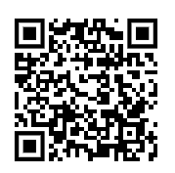
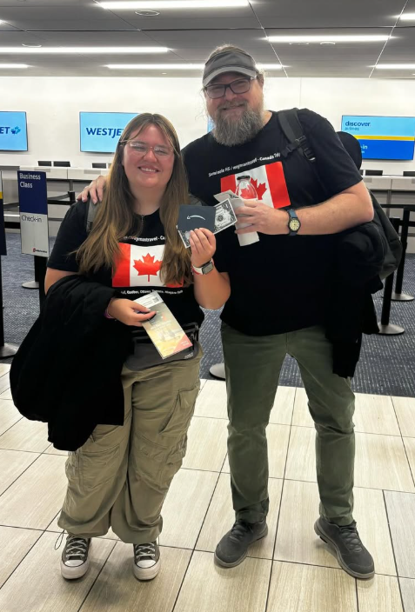
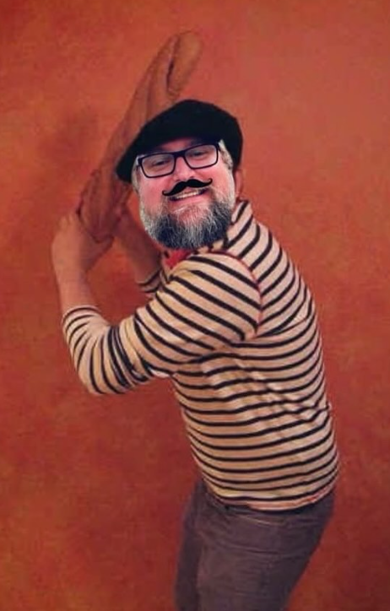
Note: No need to take notes …☺
...Unless you want to, of course.
BUT ALL INFO FROM THIS MEETING WILL BE POSTED ON MR. WAYMAN’S WEBSITE RIGHT AFTER THE MEETING:
https://waymanp.wixsite.com/educationandtravel/student-travel

Slide 3
Paris to Dalí …
Paris, Provence, & the French Riviera (including Monaco)
& Catalonia / Barcelona, Spain
June 9 - June 18, 2027

Slide 4
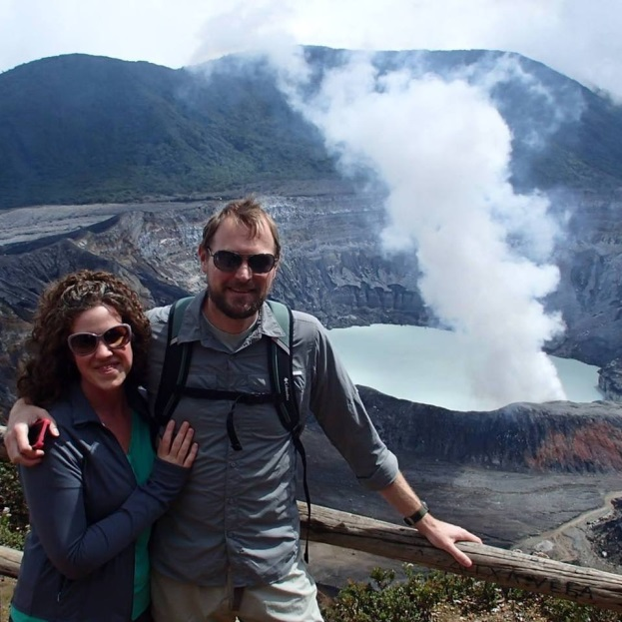
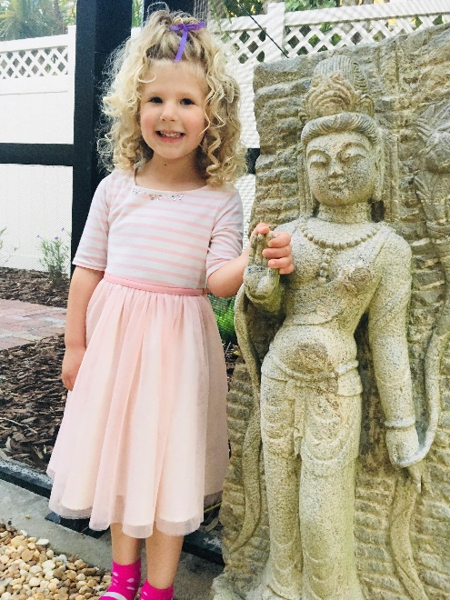
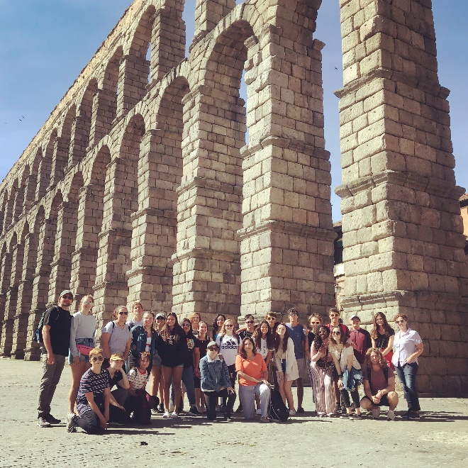



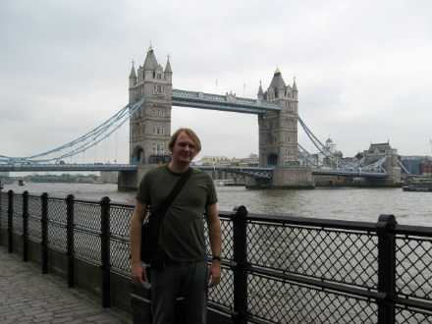
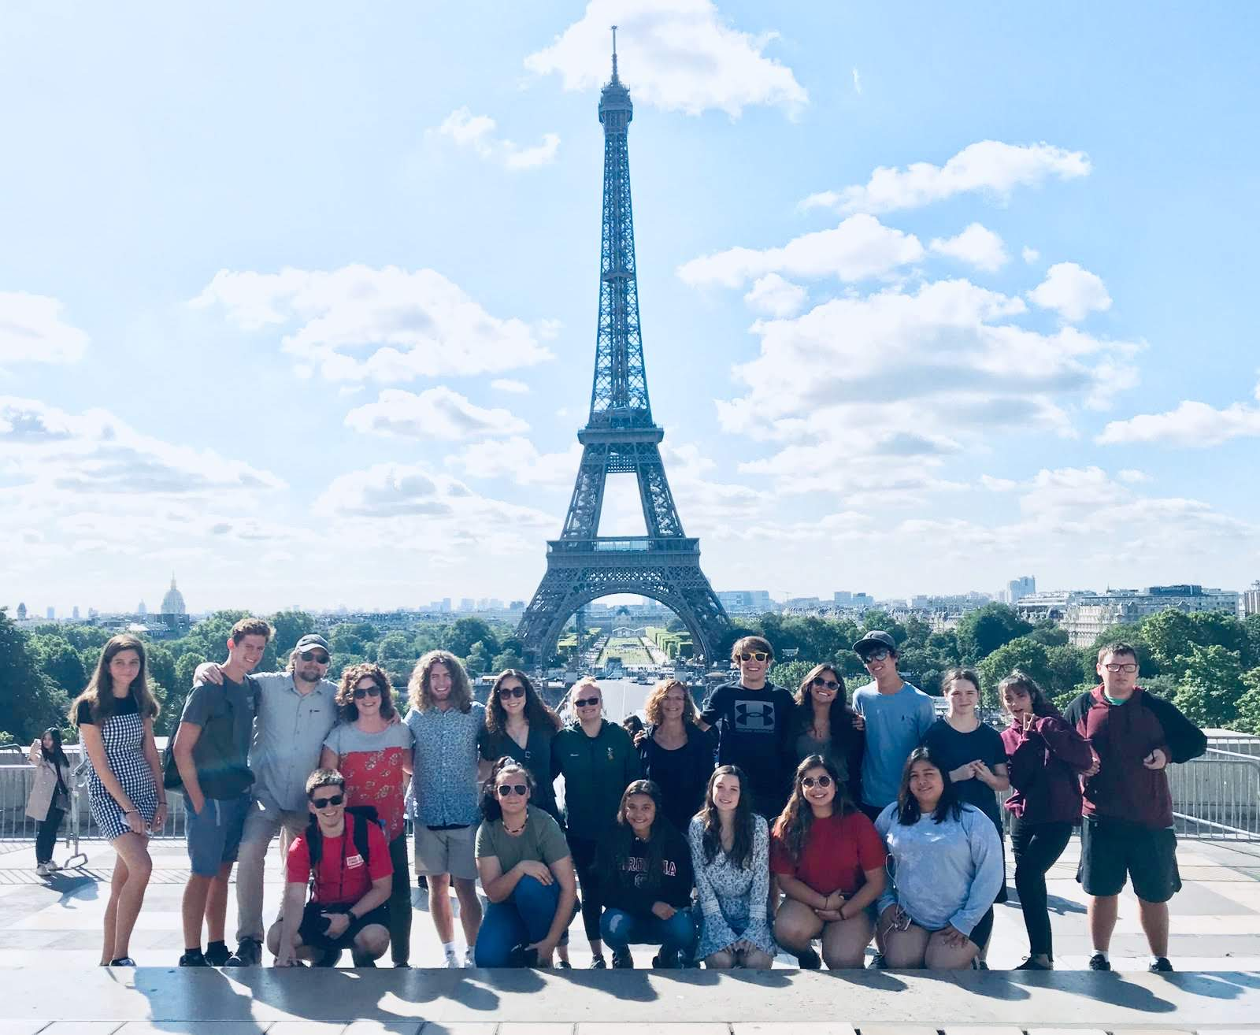
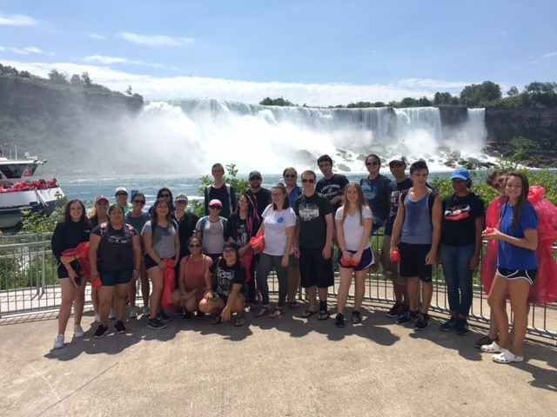
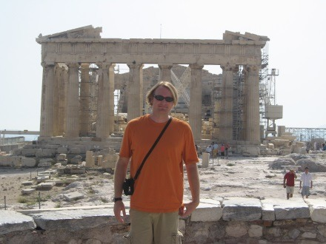
About your tour leader, Mr. Wayman…
Click here to learn more about Mr. Wayman.

Slide 5
Disclaimer…
Please note that as a general rule, neither PCSB nor SHS endorse international travel, nor are they approving or endorsing my or any of my chaperones views on the international travel (due to liability). However, per PCSB policy, teachers are permitted to travel with students internationally, but we are required to inform you of their views via the disclaimer above, and we are required to follow PCSB guidelines in promoting our educational tours using email that is not affiliated with PCBS, and meetings must be held off campus. In all cases, we are still held to the same professional standards. This will be my 11th international student tour, and I have successfully taken kids to 12 different countries, and in each case, the kids had an amazing, and safe experience. Additionally, although she cannot “officially” endorse this trip, I have met with our principal, Mrs. Brown, and she thinks this is a wonderful opportunity for our students—and I have her full blessing & support to plan the trip according to established PCSB guidelines. ☺

Slide 6
About your chaperones…
Tour chaperone selection:
Additional tour chaperones are chosen from among select, experienced PCSB teachers, who I know well, and who are highly-respected (among administration and students)—and who I know will put students first in making this trip the best possible experience that it can be for them. I follow very strict selection guidelines, based on many criteria (including travel experience, “with-it-ness", work ethic, linguistic ability, how the teachers get along with the students--and many other factors.)

Slide 7

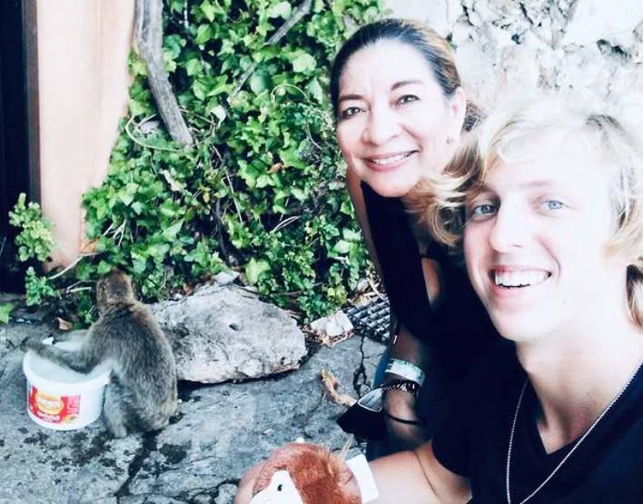
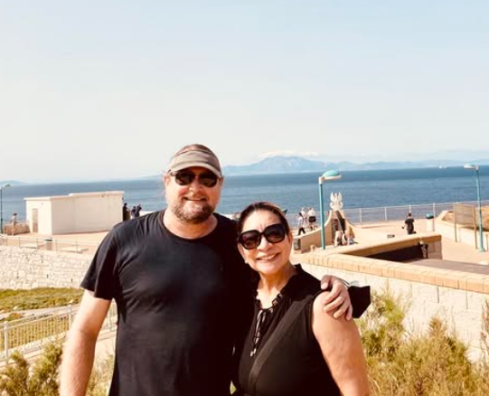
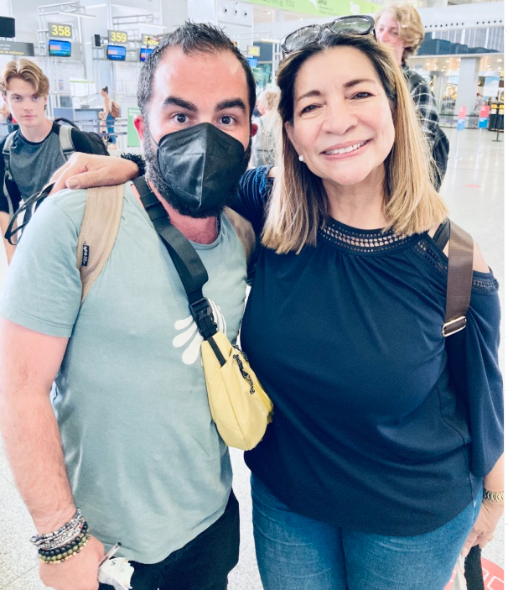
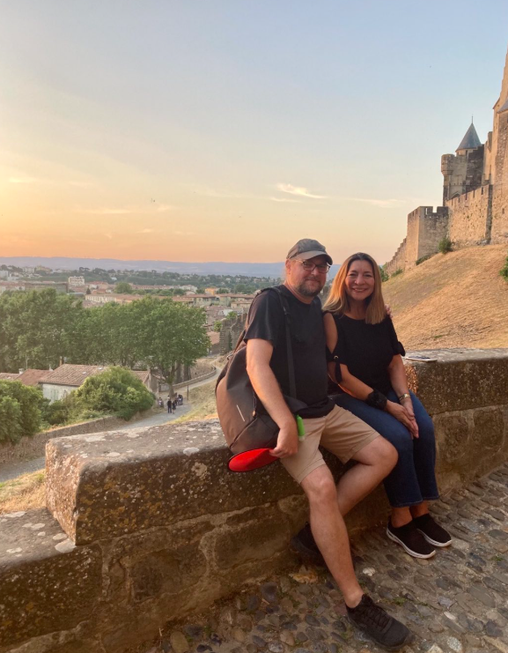
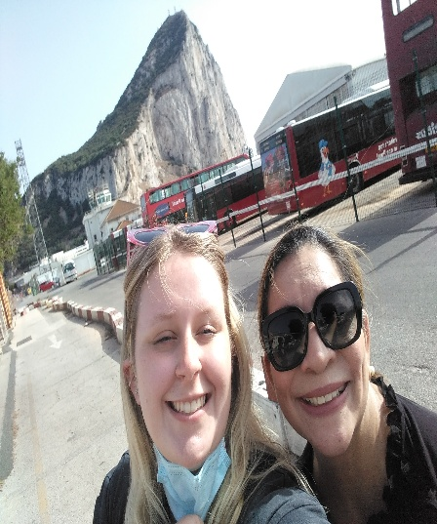
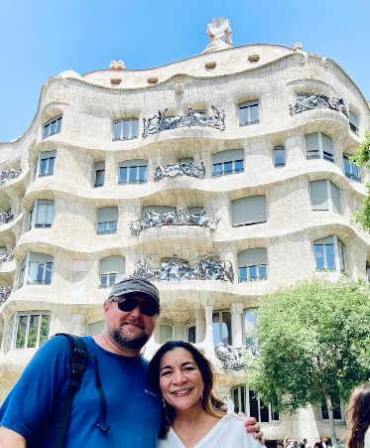
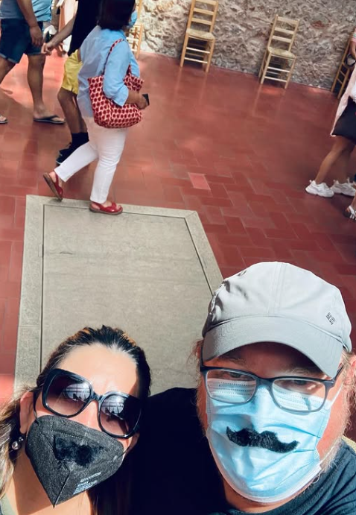
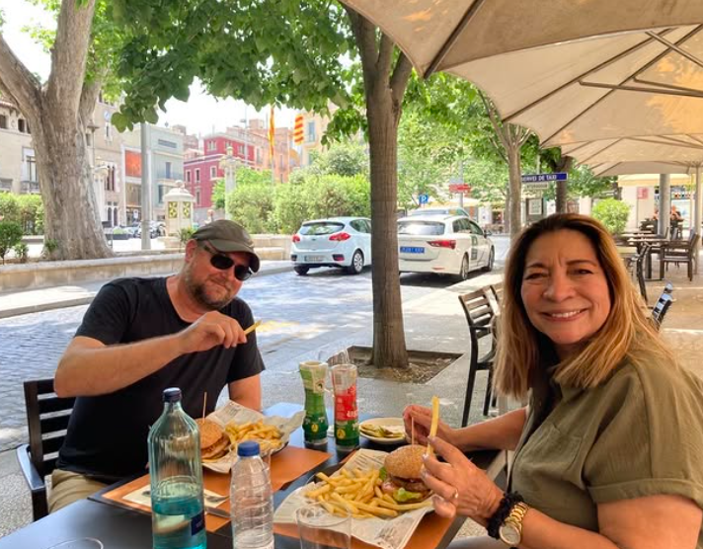
Señora Elsa Velasquez …
Spanish 2, 3H, 4H, AP teacher…
Preferred nickname: “La Jefa” (The Boss)
Notes:
Safety is, and always has been, Explorica’s top priority. They take a proactive approach to risk management that ranges from rigorous safety checks and detailed site visits, to continual safety trainings for their staff.
Our tour director will be with us 24/7 and they will post an update about our tour to a private trip log each evening. Behind the scenes, Explorica has a risk management team that’s continually monitoring conditions around the world. Their emergency support line is always on call, and their extensive network of offices means that they are always nearby to help in person if the need arises.
Explorica is a member of the United States Tour Operator’s Association, so your trip investment is protected by USTOA’s $1 Million Travelers’ Assistance Program, and Explorica even provides optional travel protection plans for cancellations and any other unforeseen circumstance. I’ll cover those later.
The bottom line is that Explorica has been an educational travel industry leader since 2000, so they have the experience, resources and coverage we need for a safe and worry-free trip.

Slide 8

Additional Chaperone(s) …
Currently: TBA
Note: Additional chaperone(s) will be chosen / added as the tour moves forward—1 or 2 more—depending on the makeup of the group & final number of travelers, and will be announced at a future trip meeting.
Stay tuned!
Notes:
Safety is, and always has been, Explorica’s top priority. They take a proactive approach to risk management that ranges from rigorous safety checks and detailed site visits, to continual safety trainings for their staff.
Our tour director will be with us 24/7 and they will post an update about our tour to a private trip log each evening. Behind the scenes, Explorica has a risk management team that’s continually monitoring conditions around the world. Their emergency support line is always on call, and their extensive network of offices means that they are always nearby to help in person if the need arises.
Explorica is a member of the United States Tour Operator’s Association, so your trip investment is protected by USTOA’s $1 Million Travelers’ Assistance Program, and Explorica even provides optional travel protection plans for cancellations and any other unforeseen circumstance. I’ll cover those later.
The bottom line is that Explorica has been an educational travel industry leader since 2000, so they have the experience, resources and coverage we need for a safe and worry-free trip.

Slide 9
About our tour company, Explorica…
Proven experience
  Over 30 years in student travel
  More than 1 million travelers
  Tours to 75 countries on all
  7 continents
Excellent value
  Fully inclusive
  Quality hotels, meals & activities
  Guaranteed best prices
Incredible tour directors
  Professionally trained
  Specialized in student travel
  Local, multi-lingual experts
  With group 24/7
Exceptional safety record
  Proven systems in place at all levels of operations
  Unmatched in industry
Safety above all else
  Proactive risk management
  Expertly trained, multilingual
  tour directors
  24/7 emergency support
  TD & Tour Leader- Have CPR / basic medical training
  Network of more than 45 offices around the world
  Comprehensive liability coverage
  Trusted travel protection plans
  USTOA $1 million Travelers’ Assistance
Notes:
Explorica has been leading student tours for more than 15 years. They’ve helped over a million students and their teachers experience more than 75 countries on all seven continents.
This means they can get quality tour components—hotels, meals and activities—for a great price. In fact, they guarantee the best prices in the industry. And they include everything upfront, so there are no hidden costs later.
But price is only half the picture. What sets Explorica apart is their tour directors. When we travel we’ll get an expert tour director who will act as our host, our logistic coordinator, our translator, our go-to local expert, guiding us every step of the way while bringing the destinations to life. Explorica tour directors are the best in the business, and they’ll help us truly experience the local culture.
Explorica also has an excellent safety record, with industry-leading risk management protocols built into every aspect of their operations. Here’s how they provide total peace of mind… (switch to next slide)

Slide 10
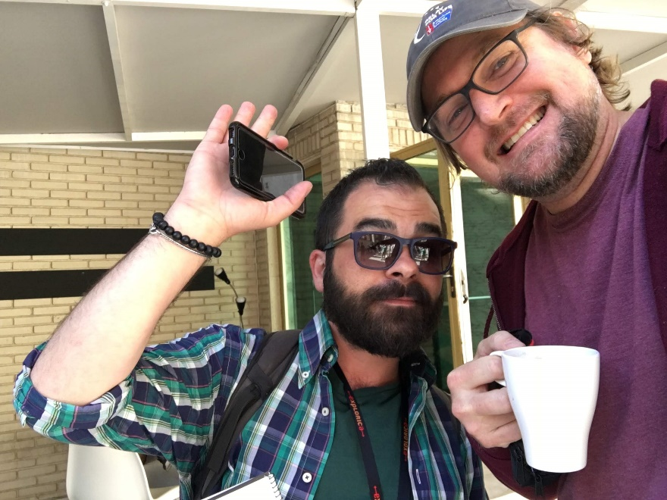
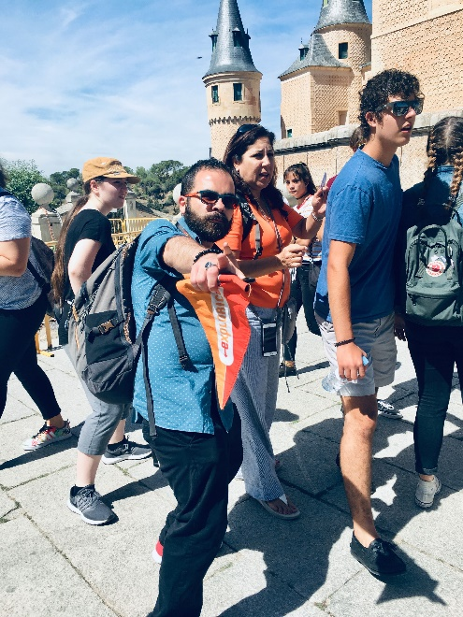
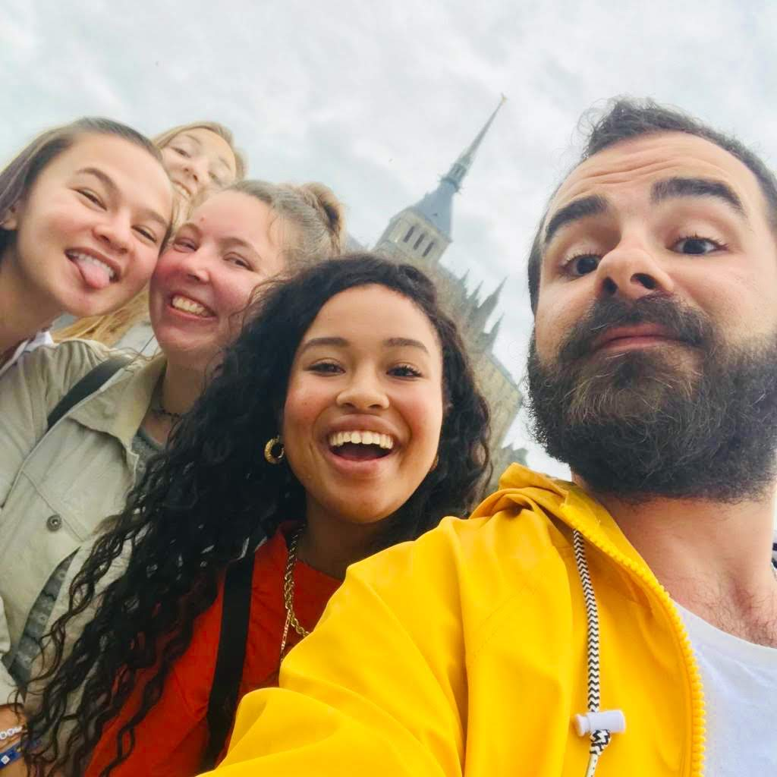
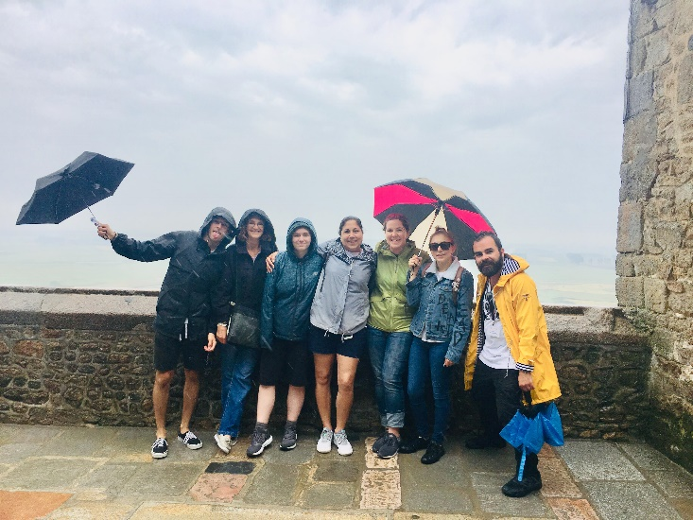

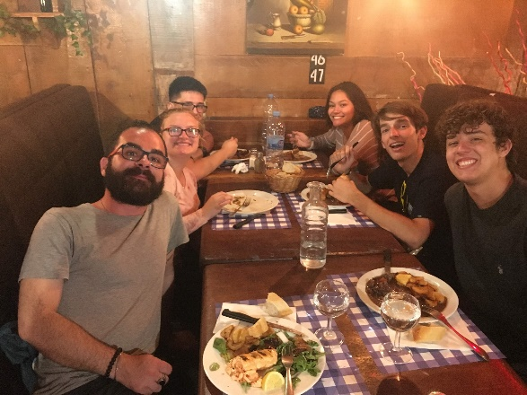
About your Explorica Tour Director, Luca Di Leonardo …
Notes:
Safety is, and always has been, Explorica’s top priority. They take a proactive approach to risk management that ranges from rigorous safety checks and detailed site visits, to continual safety trainings for their staff.
Our tour director will be with us 24/7 and they will post an update about our tour to a private trip log each evening. Behind the scenes, Explorica has a risk management team that’s continually monitoring conditions around the world. Their emergency support line is always on call, and their extensive network of offices means that they are always nearby to help in person if the need arises.
Explorica is a member of the United States Tour Operator’s Association, so your trip investment is protected by USTOA’s $1 Million Travelers’ Assistance Program, and Explorica even provides optional travel protection plans for cancellations and any other unforeseen circumstance. I’ll cover those later.
The bottom line is that Explorica has been an educational travel industry leader since 2000, so they have the experience, resources and coverage we need for a safe and worry-free trip.

Slide 11
Eligible students / traveler expectations…
In order to enroll on this tour, students MUST BE…
SHS students grades 9-12 (& graduated / early college level, on a case-by-case basis) in good academic standing, well-behaved, and have a clean discipline record—and who are taking (or have taken) French or Spanish is a major plus! ☺ ALL travelers will be screened thoroughly!
(Note about friends / brothers , sisters, parents /students at other schools,--interested in joining tour - PLEASE SEE M. WAYMAN – and it will be discussed on a case-by-case basis. ☺)
Willing to abide by the trip code of conduct / contract (including EXCELLENT BEHAVIOR AT ALL TIMES—and NO drinking alcohol). ☺
Flexible, adventurous, and ready to challenge themselves to “step outside of their comfort zone.” ☺
Willing to experience new things and recognize that they are part of a group, and to act and travel accordingly. ☺
As prepared as possible for this trip (don’t worry, we will have a several meetings beforehand, and MW will share a TON of resources with you and post all important info on the tour Website—to make sure you are super-prepared for this voyage.). ☺
Note: Students will have to sign a “good behavior” contract once enrolled. As tour leader,. Mr. Wayman reserves the right to cancel anyone before departure due to certain incidents (disobedience, violence, drug & alcohol-related offenses, etc.). Also, students who commit such acts during the tour are subject to being sent home immediately, at their, or their parents expense. In the former case, money would be refunded in accordance with our Travel Protection Plan, if purchased. Also, the tour leader reserves the right to deny anyone
permission to enroll on this tour, for reasons of concern.

Slide 12

About this tour…
This is a private tour (not mixed with random groups). The travel dates are: June 9 – 18, 2027
This tour will be a great experience for all participants.
This private / custom tour is a balance of:
Cultural immersion - So kids can practice their language skills (and they will also get to experience the distinct cultural regions of Provence in France, and Catalonia in Spain—as well as the Principality of Monaco, and Italian Nice). 6 languages may be encountered on this trip!
Learning about history - Museum & guided tours of all major cities & sites, - including SEVERAL UNESCO World Heritage Sites
Seeing the natural beauty of France and Spain - The picturesque French countryside, the lavender fields of Provence, the Mediterranean Sea, and the beautiful and unique cultural region of Catalonia in northeast Spain, …
And Fun Eiffel Tower ascent, high-speed rail trip, Seine River boat cruise, Montjuic cable car ride above the Mediterranean, exploring (and shopping in) historic city centers, people watching / looking out for famous people / folks who have passed on in Pere LaChaise Cemetery (& in Monaco) -and participating in Mr. Wayman’s super-fun / engaging daily scavenger hunts and photo / video contests (for prizes–including Amazon Gift Cards)

Slide 13

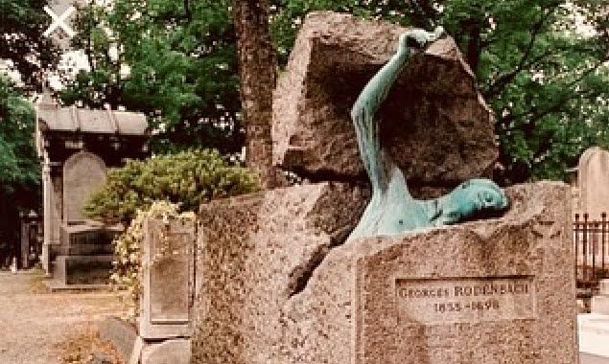




Highlights of what we will see ,visit, & do in Paris …
Eiffel Tower Ascent
Père La Chaise Cemetery
Louvre Museum
Notre Dame Cathedral
Seine River Cruise
TGV to Provence
(As well as a full city walking / bus tour , free time for shopping / lunch--and authentic French cuisine for dinner)

Slide 14
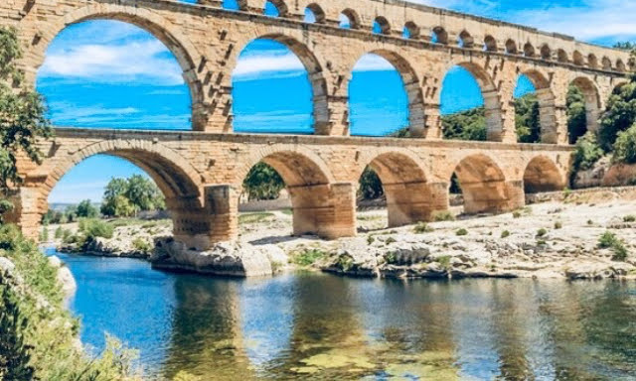
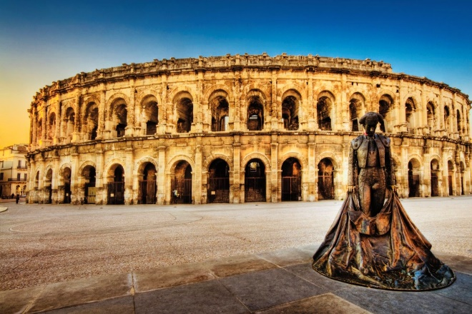

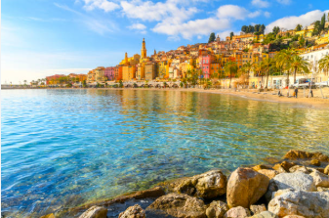
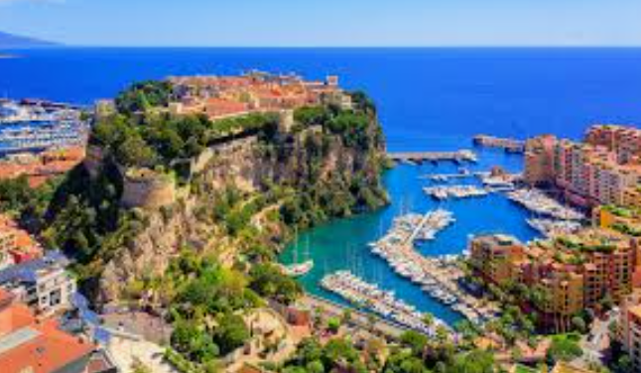
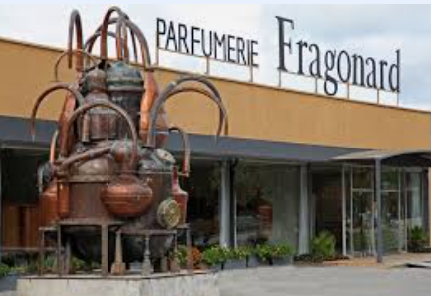
Highlights of Provence & Côte d’Azur …
Pont du Gard
Nîmes Amphitheater
Baux de Provence
Vieux Nice
Monaco
Perfumery in Eze
(As well as city walking tours , free time for lunch / shopping, and authentic local cuisine for dinner)

Slide 15
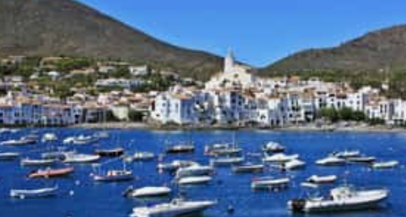









Highlights of Catalonia and Barcelona, Spain …
Figueras & Port Llegat
Dalí House Museum
Dalí Theater Museum
Casa Milà
Parc Guëll
Sagrada Familia
(As well as a full city walking / bus tours , free time for lunch / shopping and authentic Spanish cuisine---tapas & paella dinners)

Slide 16
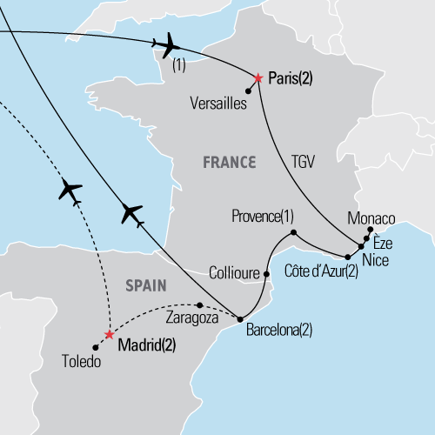
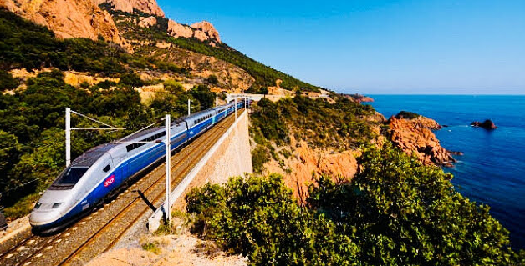
Where we’re going… (Tour details of our custom itinerary) …
  Day 1 - Start Tour
  Depart TPA → CDG (overnight flight)
  Day 2 - Bonjour Paris!
  Meet our tour director / drop bags at hotel
  Paris city walk: ÎIes de la Cité & Saint Louis,
  Latin Quarter
  Notre Dame Cathedral visit
  Dinner in the Latin Quarter
  Day 3 – Paris landmarks
  Paris guided (bus) sight-seeing tour: Arc de
  Triomphe, Champs Élysées, Eiffel Tower,
  Champ de Mars, École Militaire, les
  Invalides, Conciergerie, Tuileries, Place
  Vendôme, Opera House
  Père La Chaise Cemetery visit
  Eiffel Tower ascent
  Seine River cruise ( at sunset—very beautiful)
  Day 4 – Paris → Côte d’Azur
  Louvre Museum visit
  Travel to Nice on the TGV (bullet) train

Slide 17
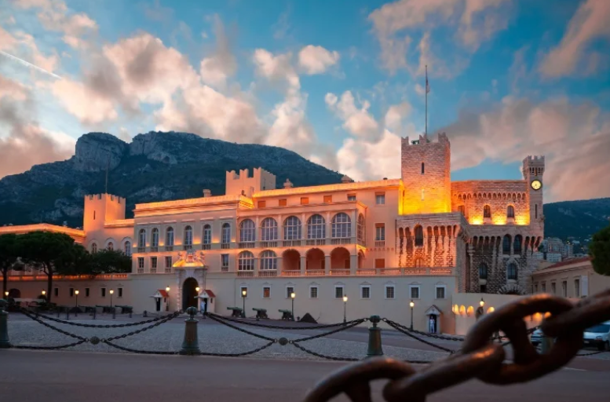
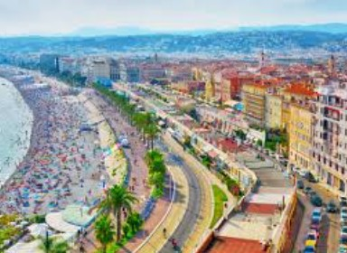

Where we’re going …
  Day 5 - Côte d’Azur ( French Riviera & Monoco)
  Monaco & Eze excursion
  Prince’s Palace of Monaco
  Perfumery visit in Eze
  Nice tour director-lead sightseeing
  Vieux Nice & Promenade des Anglais
  Day 6 - Côte d’Azur → Provence (motor coach)
  Travel to Provence
  Provence tour director-lead sightseeing
  Avignon, Pont du Gard visit
  Nîmes amphitheater visit
  Les Baux de Provence visit
  Day 7 - Provence → Barcelona (motor coach
  Travel to Barcelona via Cuollioure (a beautifull
  seaside town)
  Tapas dinner in Barcelona

Slide 18

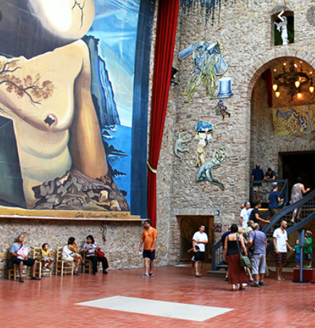
Where we’re going…
  Day 8 – Barcelona
  Casa Milà visit
  Gaudí’s Sagrada Familia guided visit
  Montjuïc cable car ride
  Barcelona guided sightseeing tour (bus & walking) – Plaça d’Espanya, Montjuïc Hill, Parc Guëll visit
  Paella dinner
  , Day 9 - Figueras & Port Llegat
  Figueras guided excursion—including the Dalí
  Theater Museum
  Dalí Home Museum visit
  Las Ramblas de Barcelona scavenger hunt
  Day 10 - Flight home from Barcelona
  Note: Depending on flight departure times, there may be an opportunity for some extra sightseeing (walking) and / or shopping time in the morning ☺

Slide 19
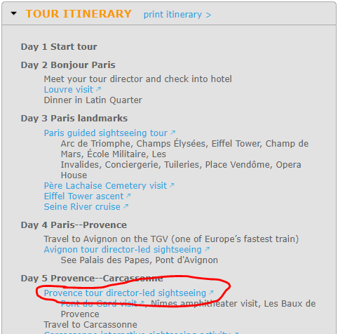
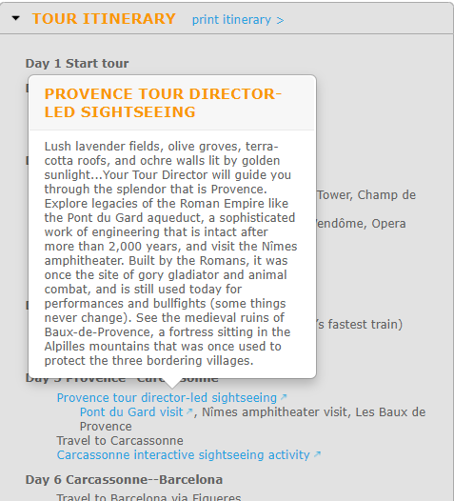
To learn more details about itinerary…
…Visit the tour sign-up page, and click on the blue links.
www.explorica.com/wayman-2027
Notes:
Safety is, and always has been, Explorica’s top priority. They take a proactive approach to risk management that ranges from rigorous safety checks and detailed site visits, to continual safety trainings for their staff.
Our tour director will be with us 24/7 and they will post an update about our tour to a private trip log each evening. Behind the scenes, Explorica has a risk management team that’s continually monitoring conditions around the world. Their emergency support line is always on call, and their extensive network of offices means that they are always nearby to help in person if the need arises.
Explorica is a member of the United States Tour Operator’s Association, so your trip investment is protected by USTOA’s $1 Million Travelers’ Assistance Program, and Explorica even provides optional travel protection plans for cancellations and any other unforeseen circumstance. I’ll cover those later.
The bottom line is that Explorica has been an educational travel industry leader since 2000, so they have the experience, resources and coverage we need for a safe and worry-free trip.

Slide 20
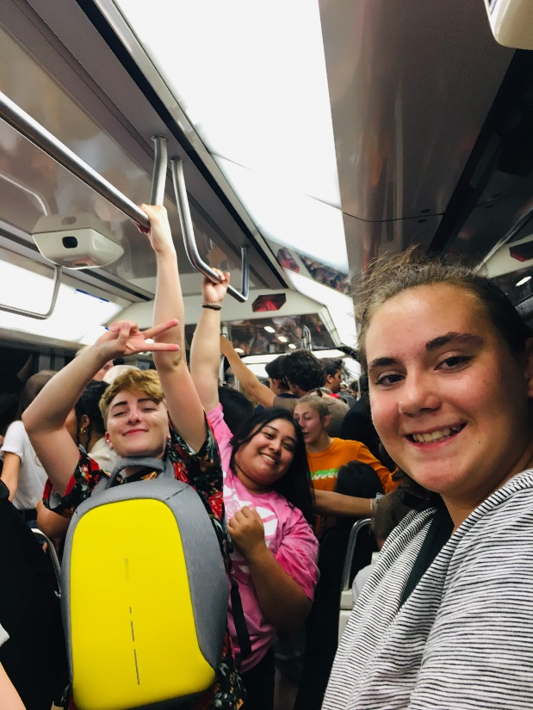

What is included …
EXPERIENCES OF A LIFETIME!—including: all guided sightseeing tours, city walks, museum & site visits as per itinerary (There are LOTS of interesting & educational things on the itinerary)
Round-trip transportation (air fare, one regulation-sized carry-on, & one checked bag), luxury motor coach, TGV train, metro passes
9 overnight stays in hotels with private bathrooms (triples / quads) – upgraded hotels in Paris & Barcelona!
Breakfast (at hotels) & dinners (at local restaurants) daily
Full-time services of a professional Explorica Tour Director (with us 24/7, the whole trip)
On-Tour Tipping
College credit available ( See MW for details)
Note: NOT included in the tour fee: transportation to / from airport (upon departure and return) lunch (which is during free time), spending $, excessive baggage fees, optional travel insurance, or passport fees

Slide 21
Pricing Details…
Tour fee breakdown:
$5416
+Private group fee = $118
+On-tour tipping = $106
= $5640
- $200 early registration discount
= $5440
*Tour fee schedule (this tour fee is based on 30—however our cap is at 40. We purposely price the tour at 30, in case we do not reach our goal of 40.
15-19 Travelers + $489
20-24 Travelers + $309
25-29 Travelers + $196
30-34 Travelers + $118 (Already included in tour fee)
35-39 Travelers - $61
*40 + Travelers - $0 additional tour fee
*So with early registration, and if we meet our goal (and capped amount) of 4o travelers—the tour fee would decrease by $118. And, note: We have always had a minimum of 25.
Qualifying families can also receive an additional $150 of off the tour fee in financial assistance (annual house hold income below $55k). See me for details.
Also, once enrolled, travelers get their own go-fund-me-type of fundraiser
page—which is an excellent way to help fundraise for the tour.
Note:*Save $200 off the tour fee! Sign up by December 31st, 2025 and during enrollment, us the discount code:
2027EarlySavings

Slide 22
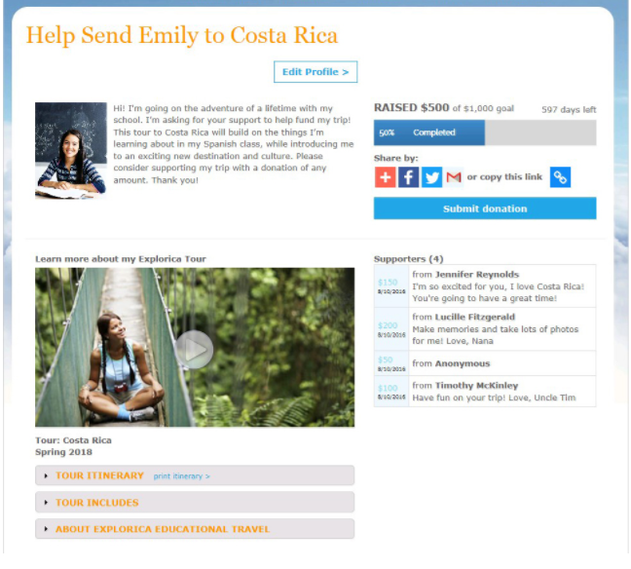
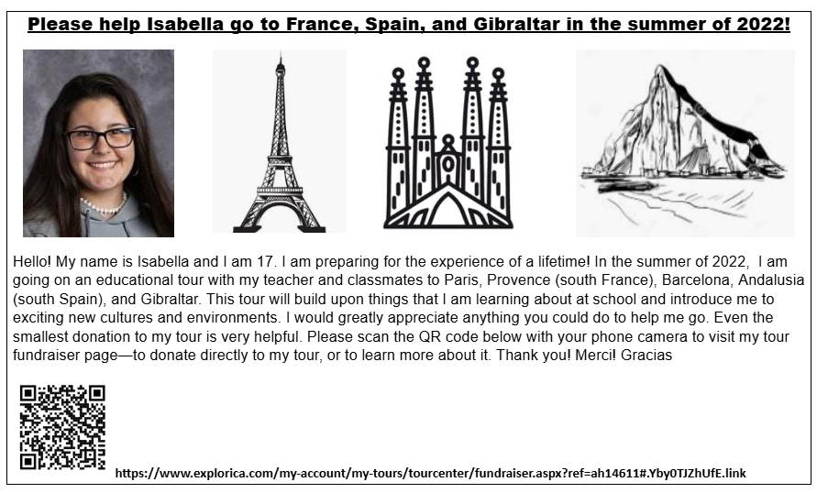
Sample fundraiser page / flyer …
Click here to see an example fundraiser page /
to learn more about fundraising for this trip.
Note: All funds raised via the site will come off of the final balance right away

Slide 23
Payment options…
1) Automatic monthly payment plan
  Most popular
  $50 deposit paid upon registration (or any amount you wish, but $50 is required)
  Balance divided into equal monthly installments (approx. $300 right now) until about 35 days before departure
  Payments charged automatically (CC or checking)
2) Manual payment plan
  $99 deposit paid upon registration
  Balance divided into 4 installments
  Payments rendered manually
  3) Pay in full
Fundraising support
  Personal fundraising page
  on explorica.com
  Easily request and accept
  credit card donations from
  friends and family
Financial assistance
  Need-based support for
  qualifying families
  Confidential application
Note about “extended” payment plans under special circumstances …
Note about “Mr. Wayman” scholarships
Notes:
Explorica is committed to making their tours attainable, so they do a couple of really helpful things that you can take advantage of:
They provide every traveler a personal fundraising page on explorica.com, enabling you to raise money for your trip using social media.
They offer need-based financial assistance, and you can find out if you qualify with one simple phone call.
And they offer payment plans that let you break up your tour fee into multiple installments. There are two options:
The automatic payment plan is the easiest, spreading out your payments over the months leading up to your tour. With this option, you only need $50 to sign up.
Or if you prefer manual payments, you can put down a $99 deposit then pay the remaining balance in four installments.
Details on each plan and financial assistance can be found in your trip invitation letter.

Slide 24
Details on 4-step payment structure…
Tour fee: $5640______________________________
-$200 early registration discount. Balance = $5440
-$100 (step 1) due at enrollment. Balance = $5340
-$500 (step 2) payment due in 30 days. Balance = $4840
-75% (step 3) of the $4840 balance ($3630) due at 110 days before tour (February 19th, 2027). Balance = $1210
- $1210 / final 25% (step 4) due 65 days before the tour (April 5th, 2027). Balance = $0___________________
Note: Currently, we are about 574 days away from the tour start date. So this 4-step option requires about $600 the first 2 months, and then well over a year until the next installment is due (*but you can make payments anytime in between, in any amount).____________________
*Also, Explorica is really easy and flexible to work with, should you need to change payment options.

Slide 25


Travel protection with Trip Mate (available / optional)…
Travel Protection Plan
  Lost tickets, passport, luggage, etc.
  Sickness or injury on tour
  And more
  See Website for rates
  Travel Protection Plan PLUS
  - Everything in the standard plan
  Plus exclusive Cancel for Any Reason protection
  See Website for rates
More info: https://www.explorica.com/resources/travel-protection-plan.aspx
Notes:
So, what happens if you have to cancel? No one wants to miss the trip of their dreams, but sometimes life happens. Explorica has two plans through TripMate that help you protect your investment, both of which provide a cash refund.
The standard plan covers common mishaps
And the upgraded plan adds the ability to cancel your tour for any reason up to 30 days before departure. It’s the only such “cancel for any reason” policy in the industry, and it’s a really great assurance.
Both plans are optional, but just know that they’re available to you if you’d like to purchase insurance.

Slide 26
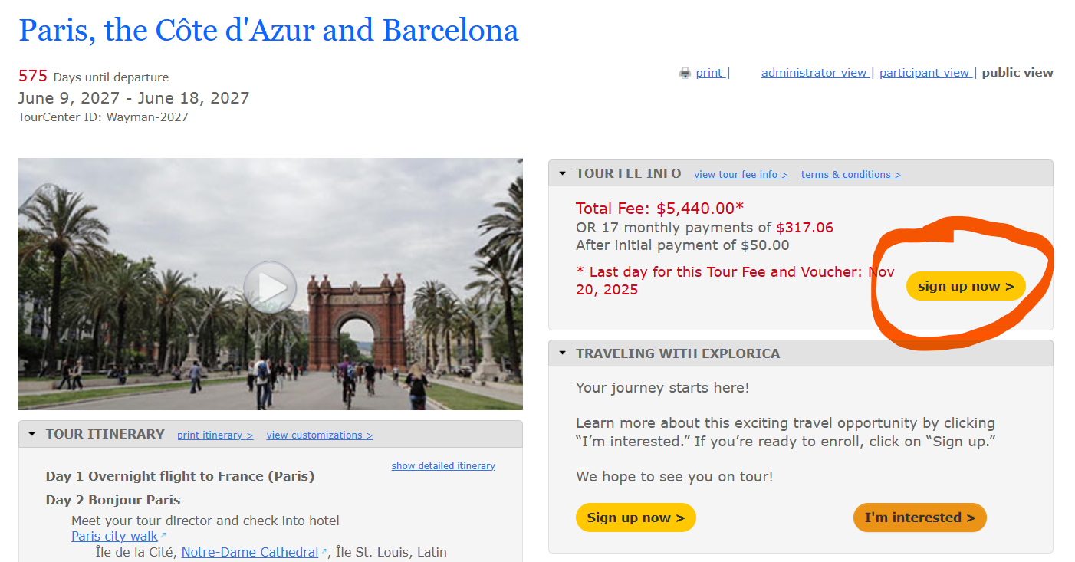

How to enroll on this tour …
Online:
  www.explorica.com/Wayman-2027
By phone:
  1.888.310.7121
  Tour ID: Wayman – 2027
Mr. Wayman: cell: 727-631-5721
waymantravel@gmail.com
(For questions or assistance)
Enter voucher code: 2027EarlySavings at enrollment for the $200 savings.
Note: All of this info is on the flyers on the table (and on my Website). ☺
Notes:
I sincerely hope that you’ll be able to join me for this once-in-a-lifetime trip, and I encourage you to sign up early to give yourself the most time to pay and prepare.
Signing up is easy, and you can do it online, by phone or by mail. You just need our Tour Center ID, which is in your invitation letter.

Slide 27
Once enrolled / in preparation for the trip…
We will have multiple meetings to ensure that all travelers are as prepared as possible for the tour (May, 2026. November, 2026. April / May, 2021). And then an optional social event just before the trip (at a local restaurant). At the meetings, we will go over all aspects of the tour, including but not limited to:
Sign up for our trip remind (to receive important trip-related info)
Meet & greet
Passports (issuance, and keeping them safe)
Required paperwork (code of conduct contract, medical forms)
Special meal requests / allergies
Packing, what you will need, what to bring / what not to bring
What you are allowed / not allowed to bring
Travelling in a group / on-tour communication
Role call / group check-ins / rooming
Personal / group safety / avoiding being pickpocketed
Ordering currency / currency exchange / handling money / using credit cards abroad
Hotel security
Travelling on public transportation
Notes:
Safety is, and always has been, Explorica’s top priority. They take a proactive approach to risk management that ranges from rigorous safety checks and detailed site visits, to continual safety trainings for their staff.
Our tour director will be with us 24/7 and they will post an update about our tour to a private trip log each evening. Behind the scenes, Explorica has a risk management team that’s continually monitoring conditions around the world. Their emergency support line is always on call, and their extensive network of offices means that they are always nearby to help in person if the need arises.
Explorica is a member of the United States Tour Operator’s Association, so your trip investment is protected by USTOA’s $1 Million Travelers’ Assistance Program, and Explorica even provides optional travel protection plans for cancellations and any other unforeseen circumstance. I’ll cover those later.
The bottom line is that Explorica has been an educational travel industry leader since 2000, so they have the experience, resources and coverage we need for a safe and worry-free trip.

Slide 28
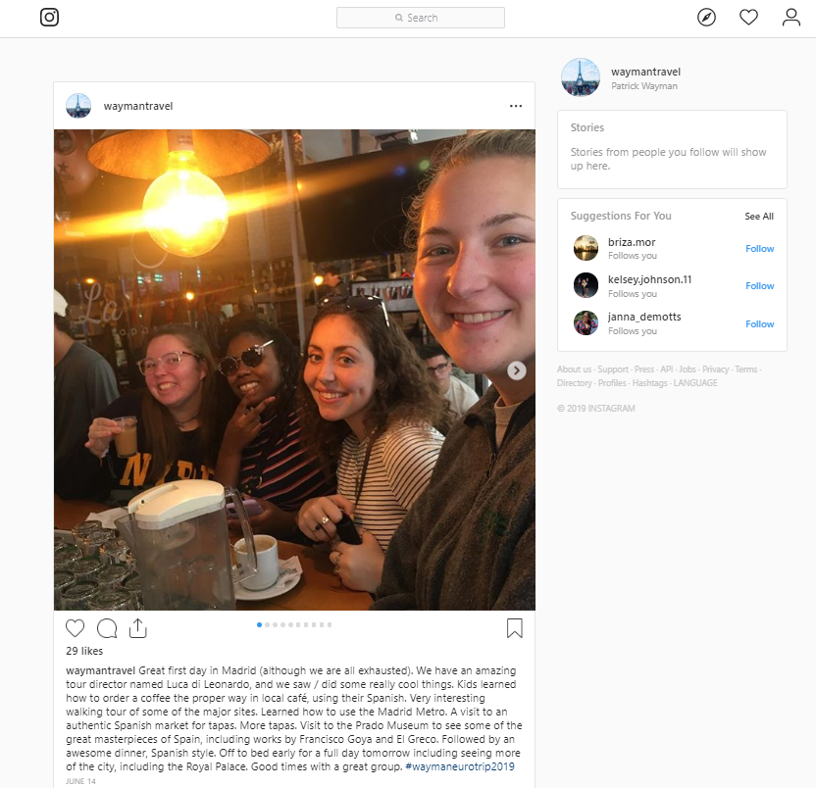


Questions?
Contact Mr. Wayman / find out more anytime:
waymantravel@gmail.com
Cell: 727-631-5721
https://waymanp.wixsite.com/educationandtravel/student-travel → → → → → → → → → → → → → → → → → →
www.explorica.com/wayman-2027
https://www.instagram.com/waymantravel/
Note: All of this info is on the flyers on the table (and on my Website). ☺

